Slide 1
Connecting VS Code and Codex
SISMID Lab: Supplementary Materials
July 22 through July 24, 2026
A Human – AI Teaming Approach to Infectious Disease Modeling

Slide 2
Roadmap
This slide deck provides a step-by-step walkthrough of connecting Codex and VS Code.
If you do not have a Codex (ChatGPT) account, you will not be able to connect Codex and VS Code. Please refer to the appropriate slide-deck to connect the AI of your choice to VS Code.
If you run into issues, please first work with the AI of your choice to troubleshoot.
If you continue to have issues, please reach out to Amanda Bleichrodt (ambleic@clemson.edu).

Slide 3
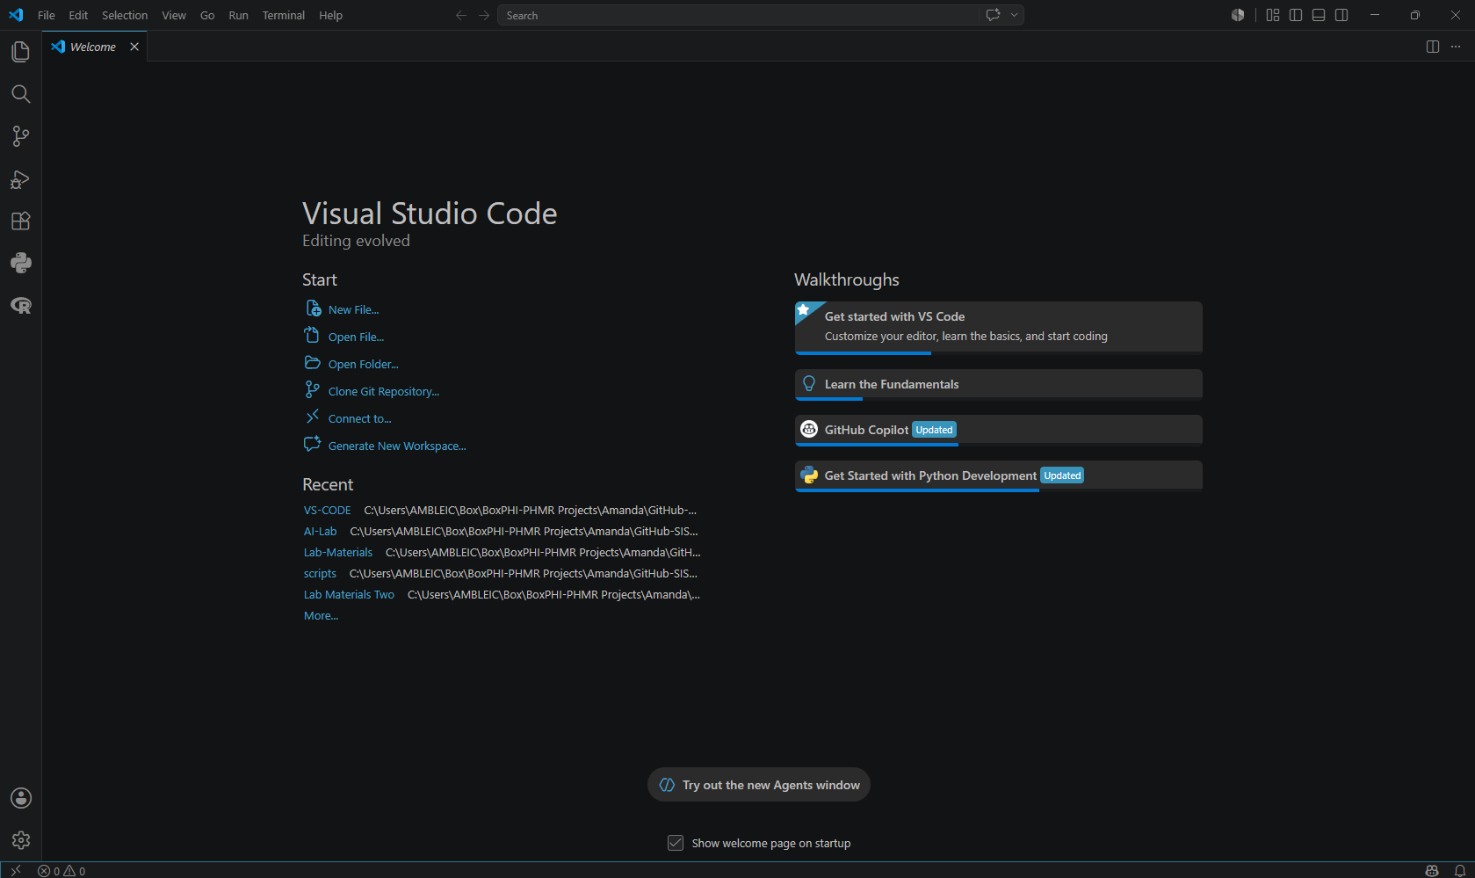
Step 1: Opening the Extensions Menu
To connect Codex to VS Code, first press:
MAC: Cmd+Shift+X
Windows/Linux: Ctrl+Shift+X
This opens the Extensions view where we can download the “Codex” extension. If that does not work, click the Extensions icon on the left side of the page.

Slide 4
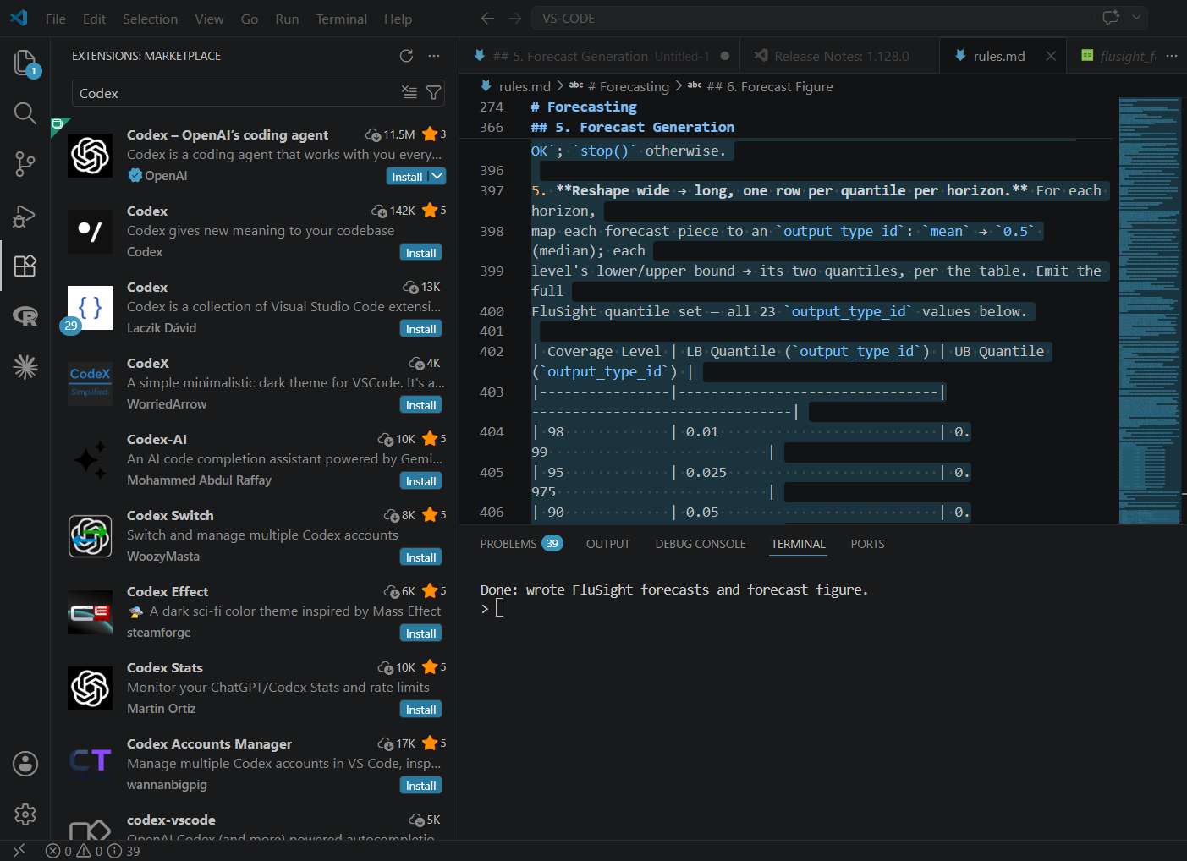
Step 2: Installing Codex
Once you have opened the Extensions Marketplace, then search for “Codex”. The first option you should see is “Codex – OpenAI’s coding agent”; click Install.

Slide 5
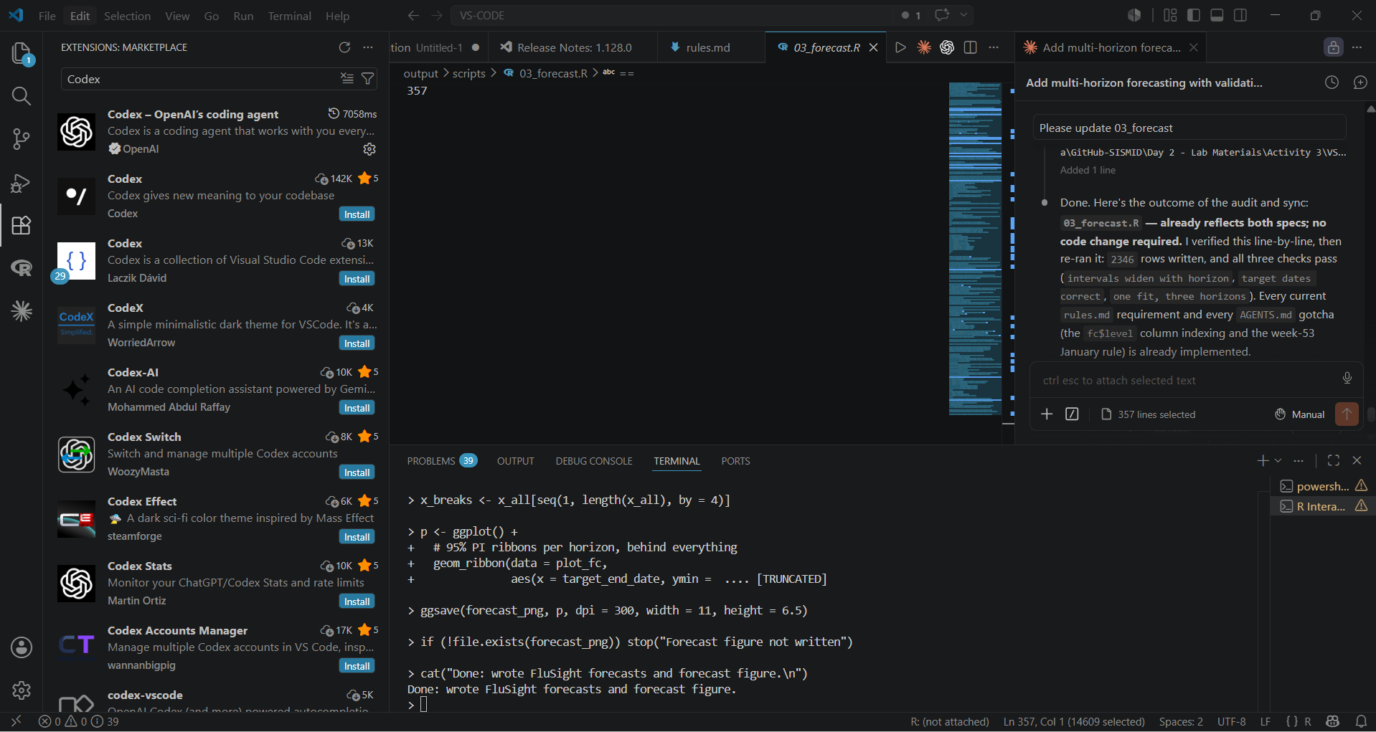
Step 3: Opening the Codex Chat
Once “Codex” has been installed, we can now open the chat box and start the process to connect our Codex/ChatGPT account to VS Code. To open the Codex chat, click the flower design in the upper right-hand corner of the page.

Slide 6
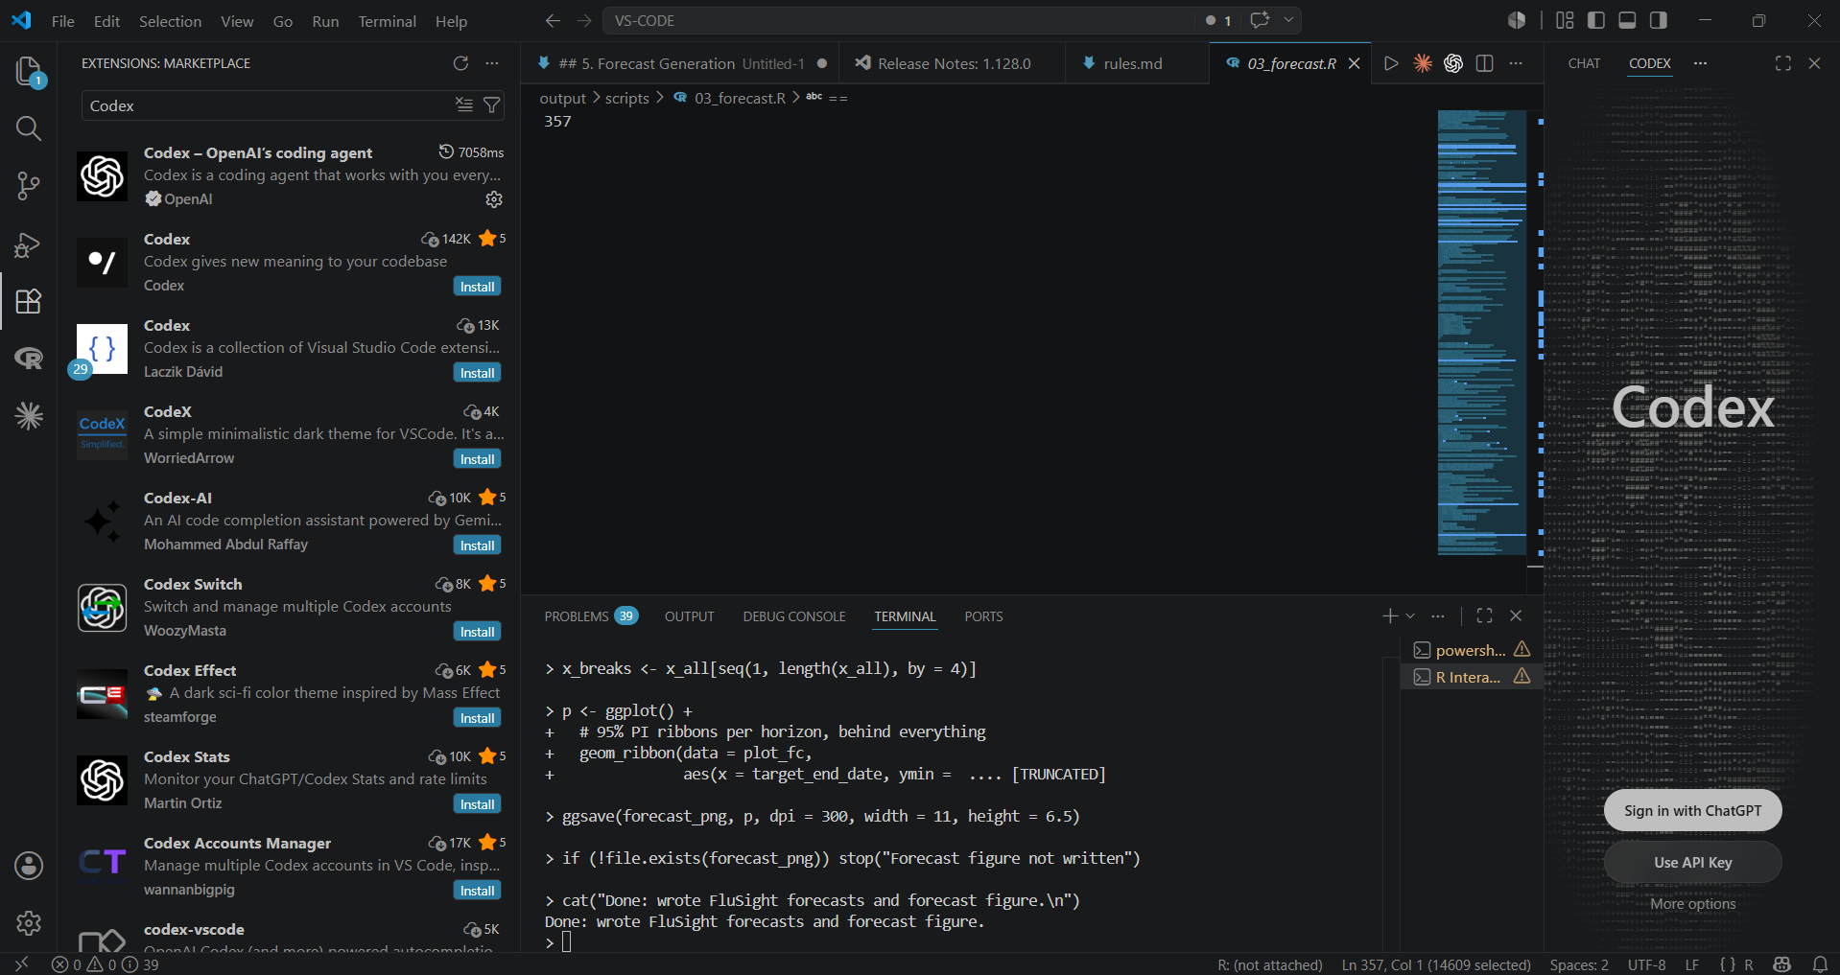
Step 4: Signing in with ChatGPT
When you first dowload Codex and open the chat box, you will be prompted to connect to your ChatGPT subscription. To start that process, click Sign in with ChatGPT.

Slide 7
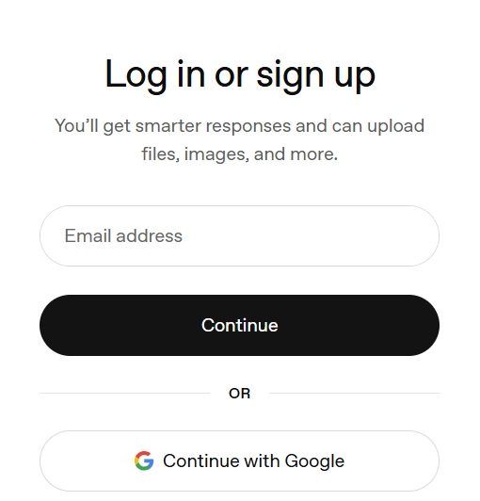
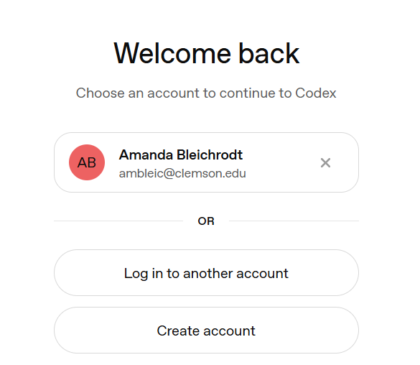
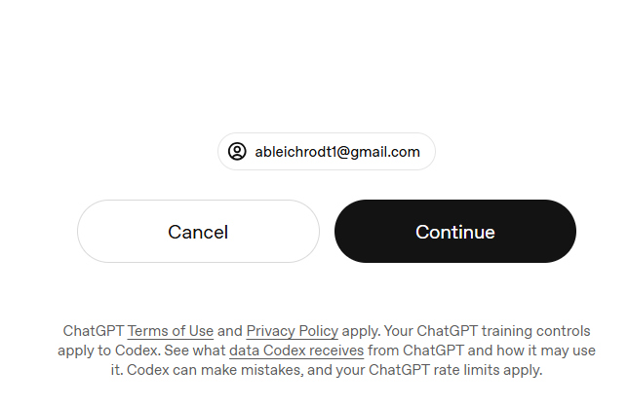
Step 5: Signing into ChatGPT
After clicking Sign in with ChatGPT, you may be prompted to Choose an account to continue into Codex. Select the account shown, or Log in to another account (i.e., choose the appropriate response for you).
If logging into another account, you will be asked to either provide the email address associated with the account, or to sign in with various 3rd party services (e.g., Google). After entering your account information, you will see one additional menu. Select Continue.

Slide 8
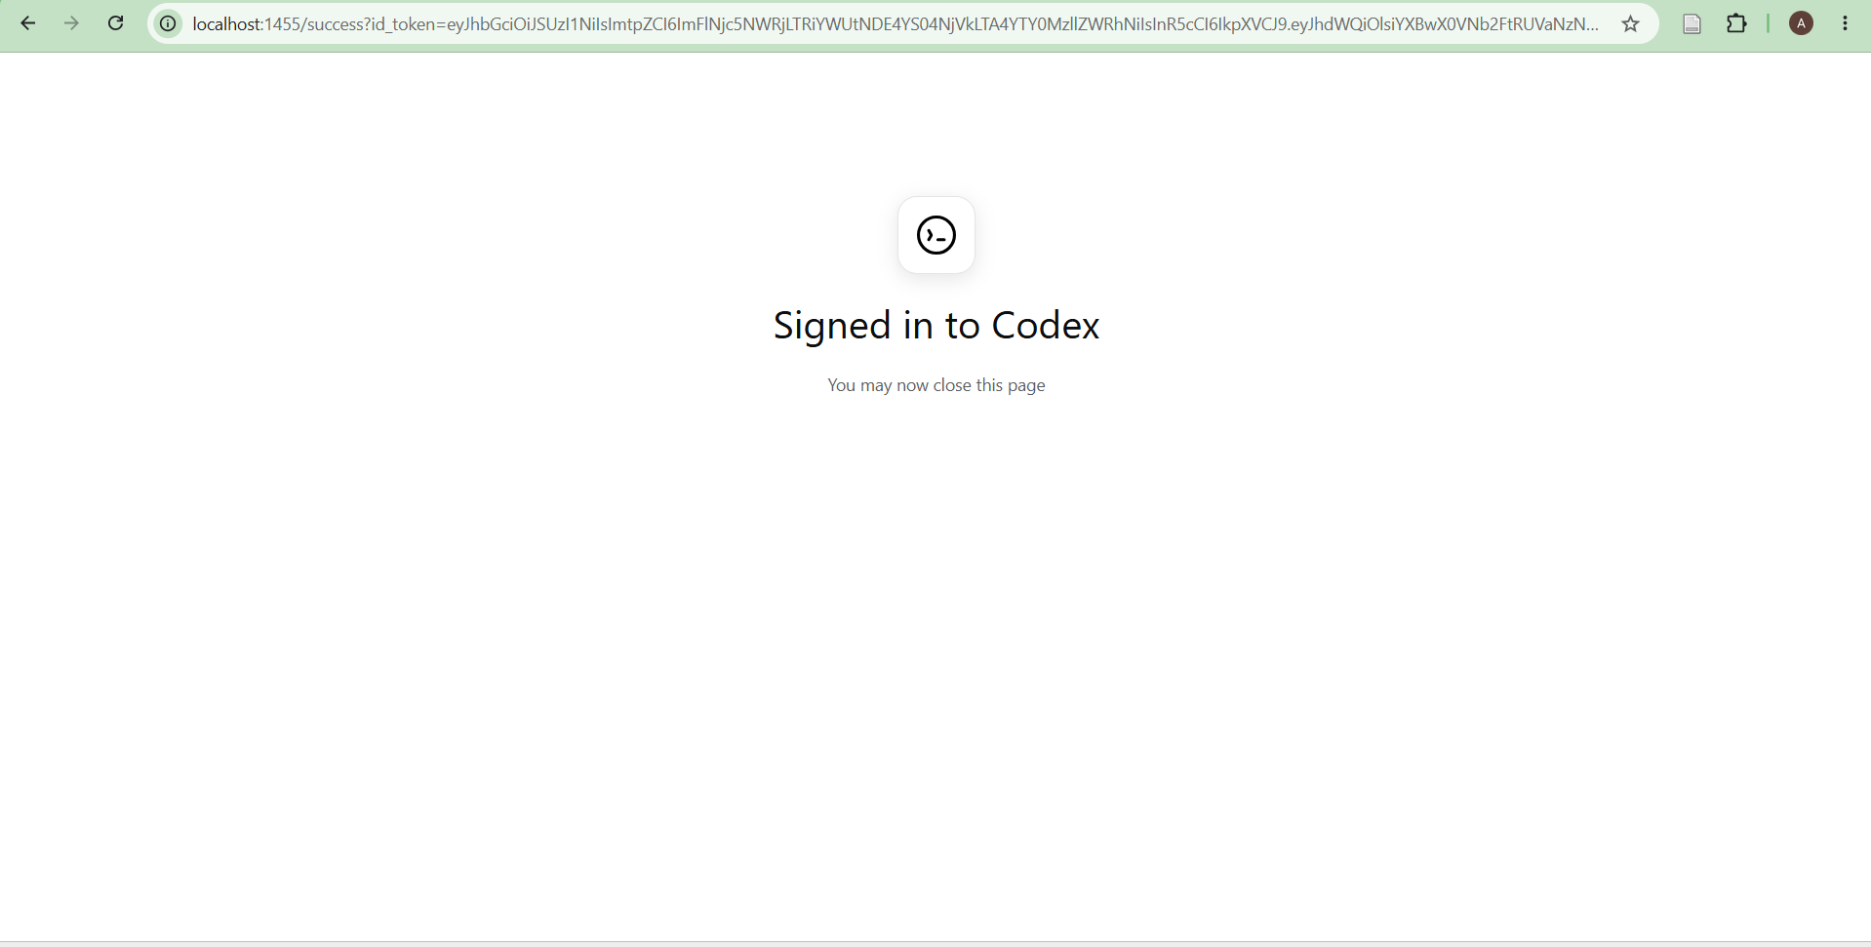
Step 6: Confirming Set Up
After logging in (Step 5) you should see Signed in to Codex. Once you make it to this screen, you can close the window and navigate back to VS Code.
If you do not see this screen, please let us know!

Slide 9
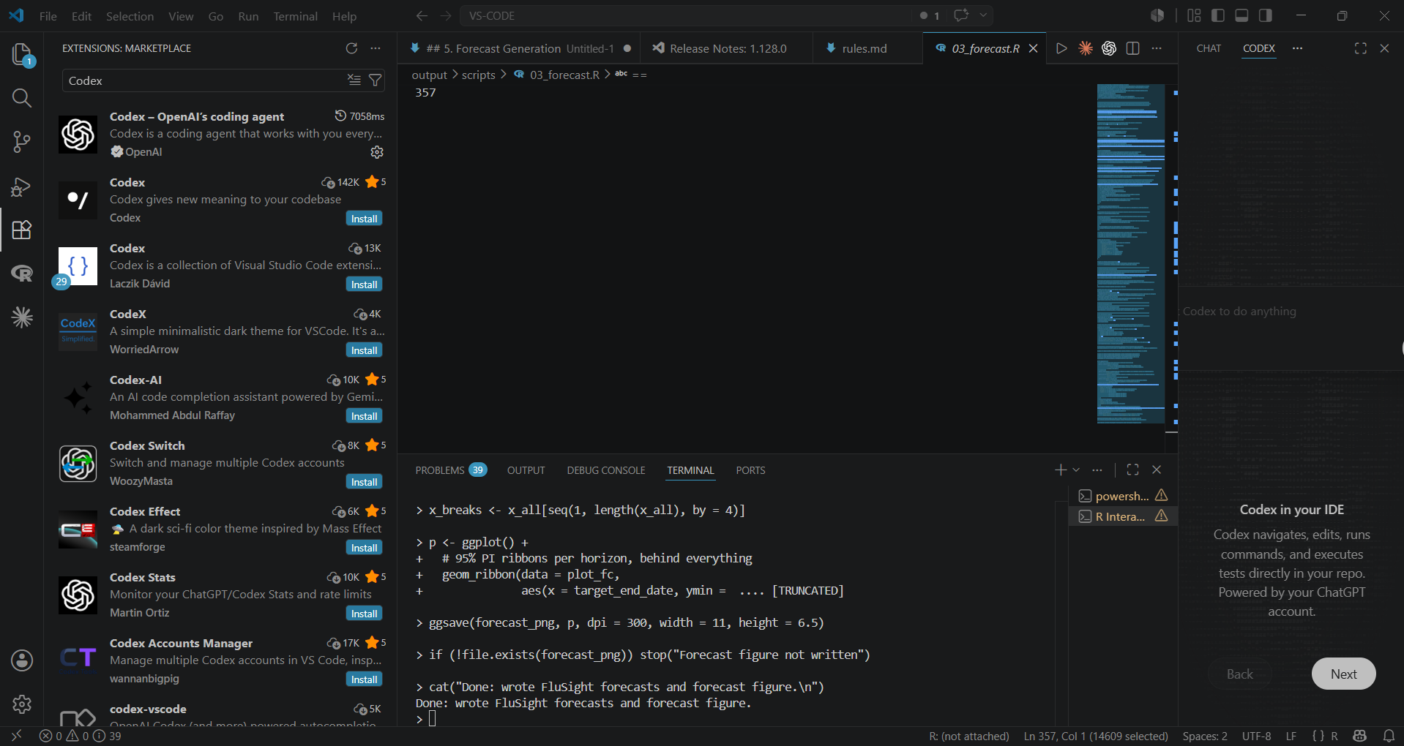
Codex in VS Code
Once you navigate back to VS Code, you should now see the chat box for Codex ready to go. If you close out the chat, you can re-open it by clicking the flower icon (Step 3).

Slide 10
Want to learn more?
https://learn.chatgpt.com/docs/codex/ide

